Slide 1
CPS 330: Case Study Pt. 1
Haris Adnan, Quan Doan, Alexander Du, Jerry Xin

Slide 2
Task 1: Preprocessing
Input: Points, Binwidth, Binheight
Divide the 2D plane into bins of size Binwidth by Binheight. From experimentation and subjective evaluation, we decided on Binwidth = Binheight = 1km.
Insert the bins as keys in a hashmap.
Iterate through the points. Compute the bin that the point falls into, and increment its value in the hashmap.
Sort the bins by the density of the center point, using sorted() from Python’s standard library, which is implemented using TimSort.
Output: A sorted hashmap of bins
Runtime: We traverse O(n) points, inserting them to a hashmap in O(1) time. We sort the hashmap in O(nlogn) time. Thus, the runtime is O(nlogn)

Slide 3
Task 1: Density Function
Input: Point, Bins
Compute the bin that the point falls into. The density at the point is the sum of the number of points contained in that bin with the number of points contained in the 8 surrounding bins.
Considering the 8 surrounding bins accounts for points that are near the border of their respective bin. While the use of bins provides a coarse estimate of density, we chose this method for its efficiency.
Output: The density of the point
Runtime: We access a hashmap 9 times. Each access takes O(1) time. Thus, the runtime is O(1).

Slide 4
Task 1: hubs(P, k, r)
Input: Bins, Number of hubs, Minimum distance between hubs
During preprocessing, we ordered the bins in order of density.
Iterate through the bins. If the center of the bin is at least r km apart from each of the already-selected hubs, we include it. Otherwise, we exclude it. The algorithm terminates once k hubs are selected.
Output: An array of k hubs at least r km apart from each other
Runtime: We check O(k) bins. For each bin, we check each of the O(k) hubs to determine if the center of the bin is at least r km away from each hub. Thus, the runtime is O(k^2) << O(n).

Slide 5
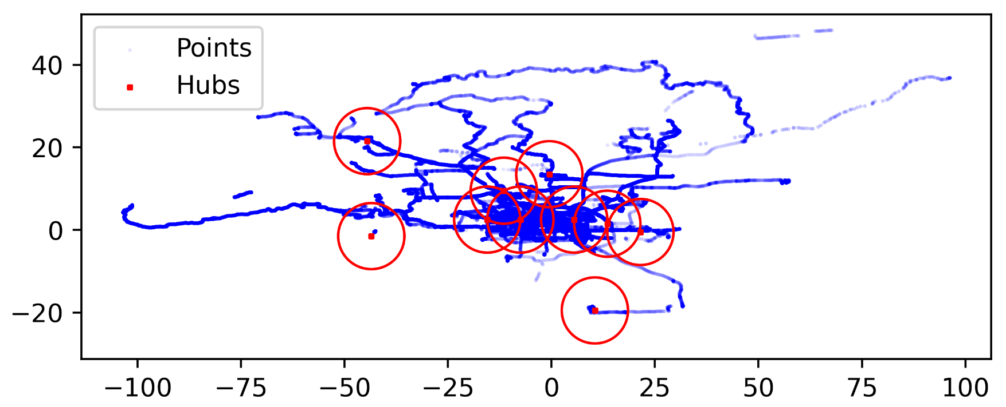
Task 1: Experimental Results
Results on the full dataset for k = 10, r = 8km

Slide 6
Task 1: Experimental Results
k = | Average Runtime (ms)
5 | 59.1
10 | 60.8
20 | 62.3
40 | 60.8
Amount of Data (%) | Average Runtime (ms)
10 | 15.3
30 | 25.5
60 | 40.3
100 | 62.7
Average runtime over 5 iterations for various sizes of k with the full dataset, r = 2km
Average runtime over 5 iterations for various amounts of data with k = 10, r = 8km

Slide 7
Task 1: Discussion
Benefits:
Very efficient
Preprocessing is done in O(nlogn) time
Finding hubs is done in O(k^2) time
Simple and easy to understand and implement
Drawbacks:
Coarse division of space: All points in the same bin have the same density
Only the center of each bin is considered as a potential hub
Future Improvements:
Divide 2D-space using a tree-like data structure, splitting the space in half in each layer. This improves accuracy but has an O(logn) access time.
Use a kNN-based algorithm, preferring points that are close to their nearest neighbors
Use an ML-based algorithm, such as kernel density estimation or DBSCAN

Slide 8
Task 2: Algorithm and Runtime Complexity
Algorithm:
The trajectory simplification algorithm first calculates the distance between a point and a line segment for each point in the trajectory T. The calculations continue until the algorithm calculates the distances for all of the points in the trajectory. The point with the max distance between itself and a line segment would now be the error of the trajectory’s simplification.
If the error is larger than the input epsilon value, then the algorithm recursively calls itself twice: one for the values before the error’s index, and the other for the values after the error’s index, and adds these results into a final list of points, which will be the simplification, or subsequence, of the input trajectory T.
Runtime:
The average runtime complexity of the trajectory simplification algorithm is O(|T|log|T|), or O(nlogn).

Slide 9
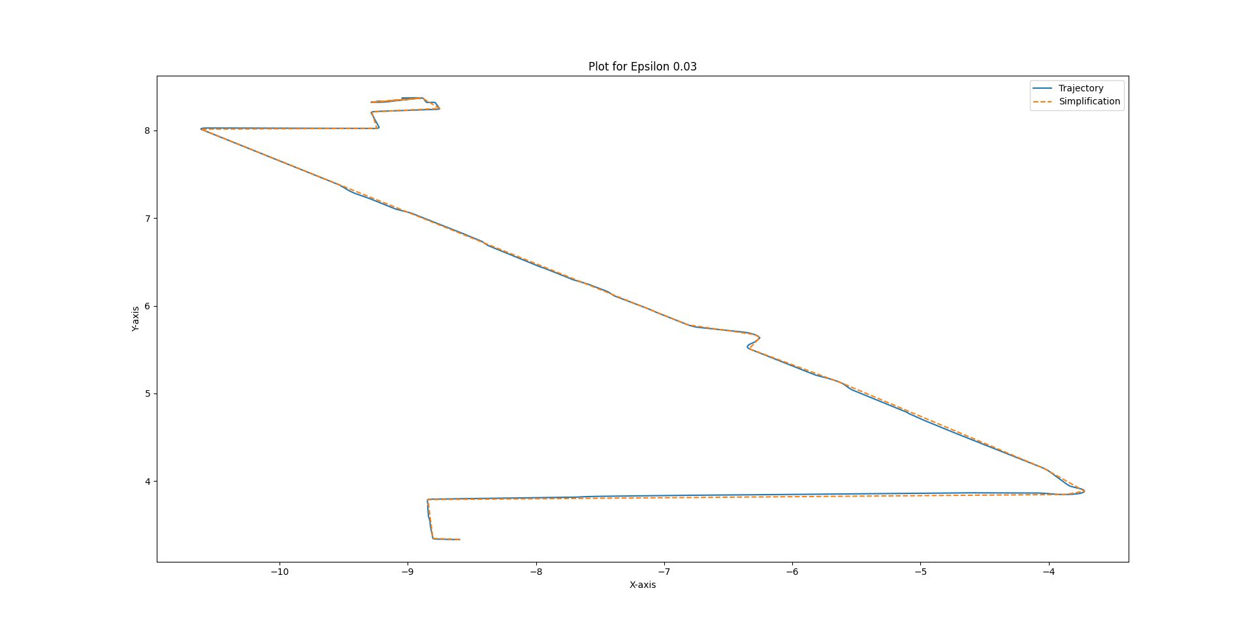
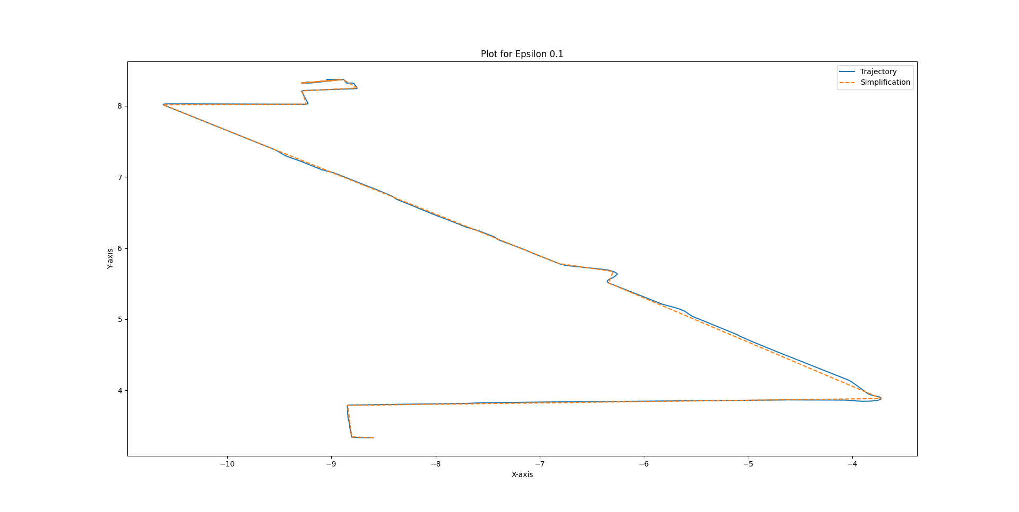
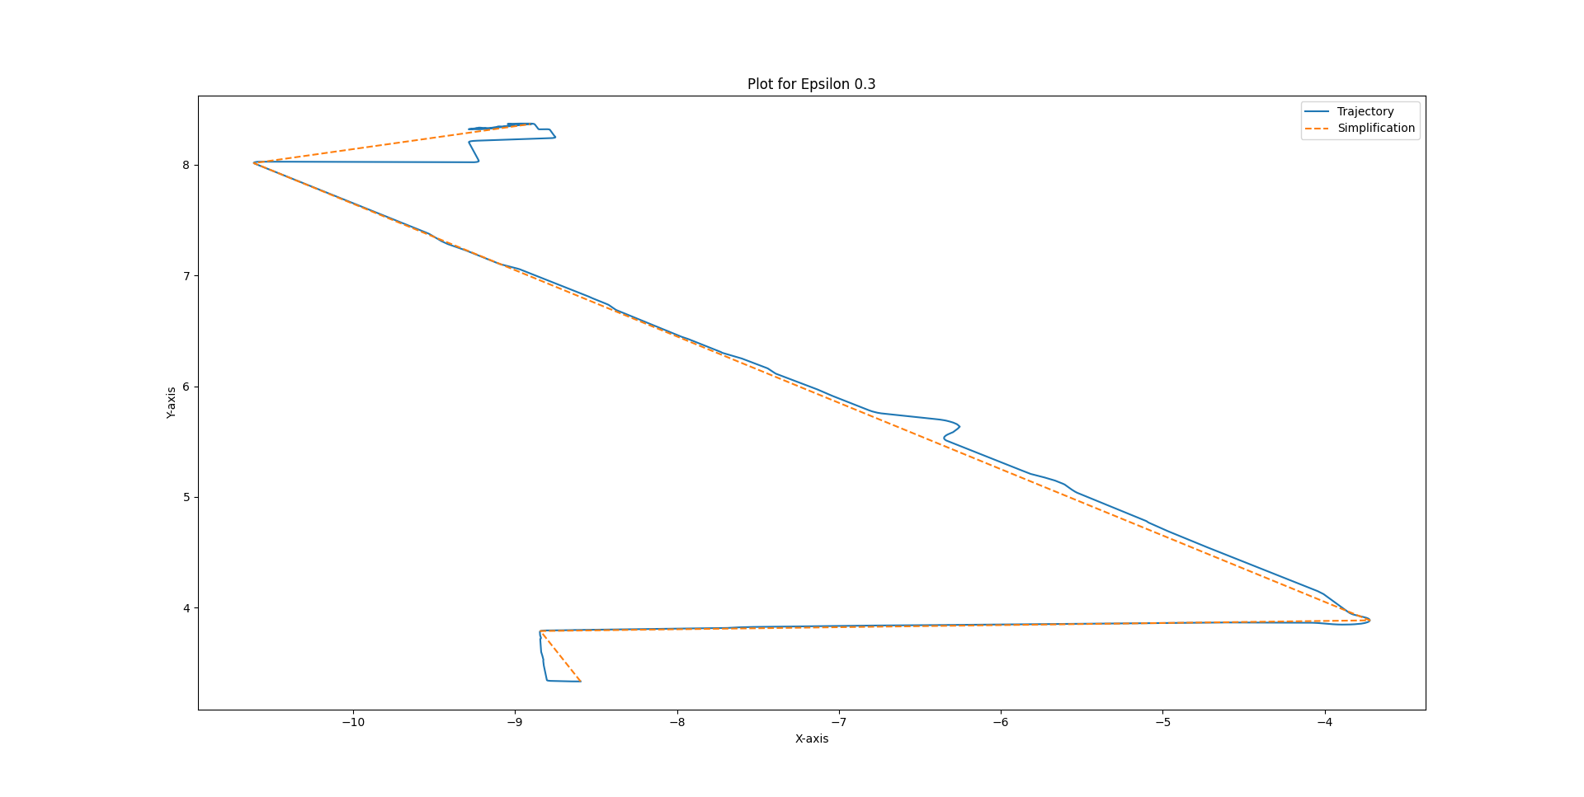
Task 2: Experimental Results
Plots of 128-20080503104400 and its epsilon-simplification for epsilon = 0.03, 0.1, and 0.3 km

Slide 10
Task 2: Experimental Results
Trajectory ID | Compression Ratio
128-20080503104400 | 17.833333333333332
010-20081016113953 | 49.36363636363637
115-20080520225850 | 35.945945945945944
115-20080615225707 | 37.94736842105263
Compression ratio (|T|/|T’|) for various trajectory IDs with epsilon = 0.03

Slide 11
Task 2: Discussion
Benefits: Best case is O(n) and average runtime is relatively fast at O(nlogn). Calculating distance is quick at O(1) and TSGreedy is relatively simple to implement and understandable.
Drawbacks: When the error of the trajectory’s simplification is a point that is at the start of the trajectory or before the last point of the trajectory, the worst-case running time would be O(n^2), which would be significantly slow with many points.
Future Improvements: For enhancement of the algorithm, improvements can be made to the worst case running time to be O(nlogn), instead of O(n^2), which would account for the case when the error is at the start of the trajectory or before the last point of the trajectory.

Slide 12
Task 3: Algorithm and Runtime Complexity
Fretchet Distance
Fretchet(i, j) is the Fretchet distance between P[0…i] and Q[0…j].
In the recurrence relation, take the max of the length of the new edge, (i, j), with the min of the predecessor pairs (i - 1, j), (i, j - 1), and (i - 1, j - 1).
Runtime/Space Complexity: O(|P||Q|) with memoization.
Dynamic Time Warping
DTW(i, j) is the Dynamic Time Warping between P[0…i] and Q[0…j].
In the recurrence relation, take the predecessor pair (i - 1, j), (i, j - 1), and (i - 1, j - 1) with the least running average. In other words, for each predecessor, multiply the size of the predecessor alignment with the DTW of the predecessor, add d^2(i, j), and divide by the size+1. Select the minimum value.
Runtime/ Space Complexity: O(|P||Q|) with memoization.

Slide 13
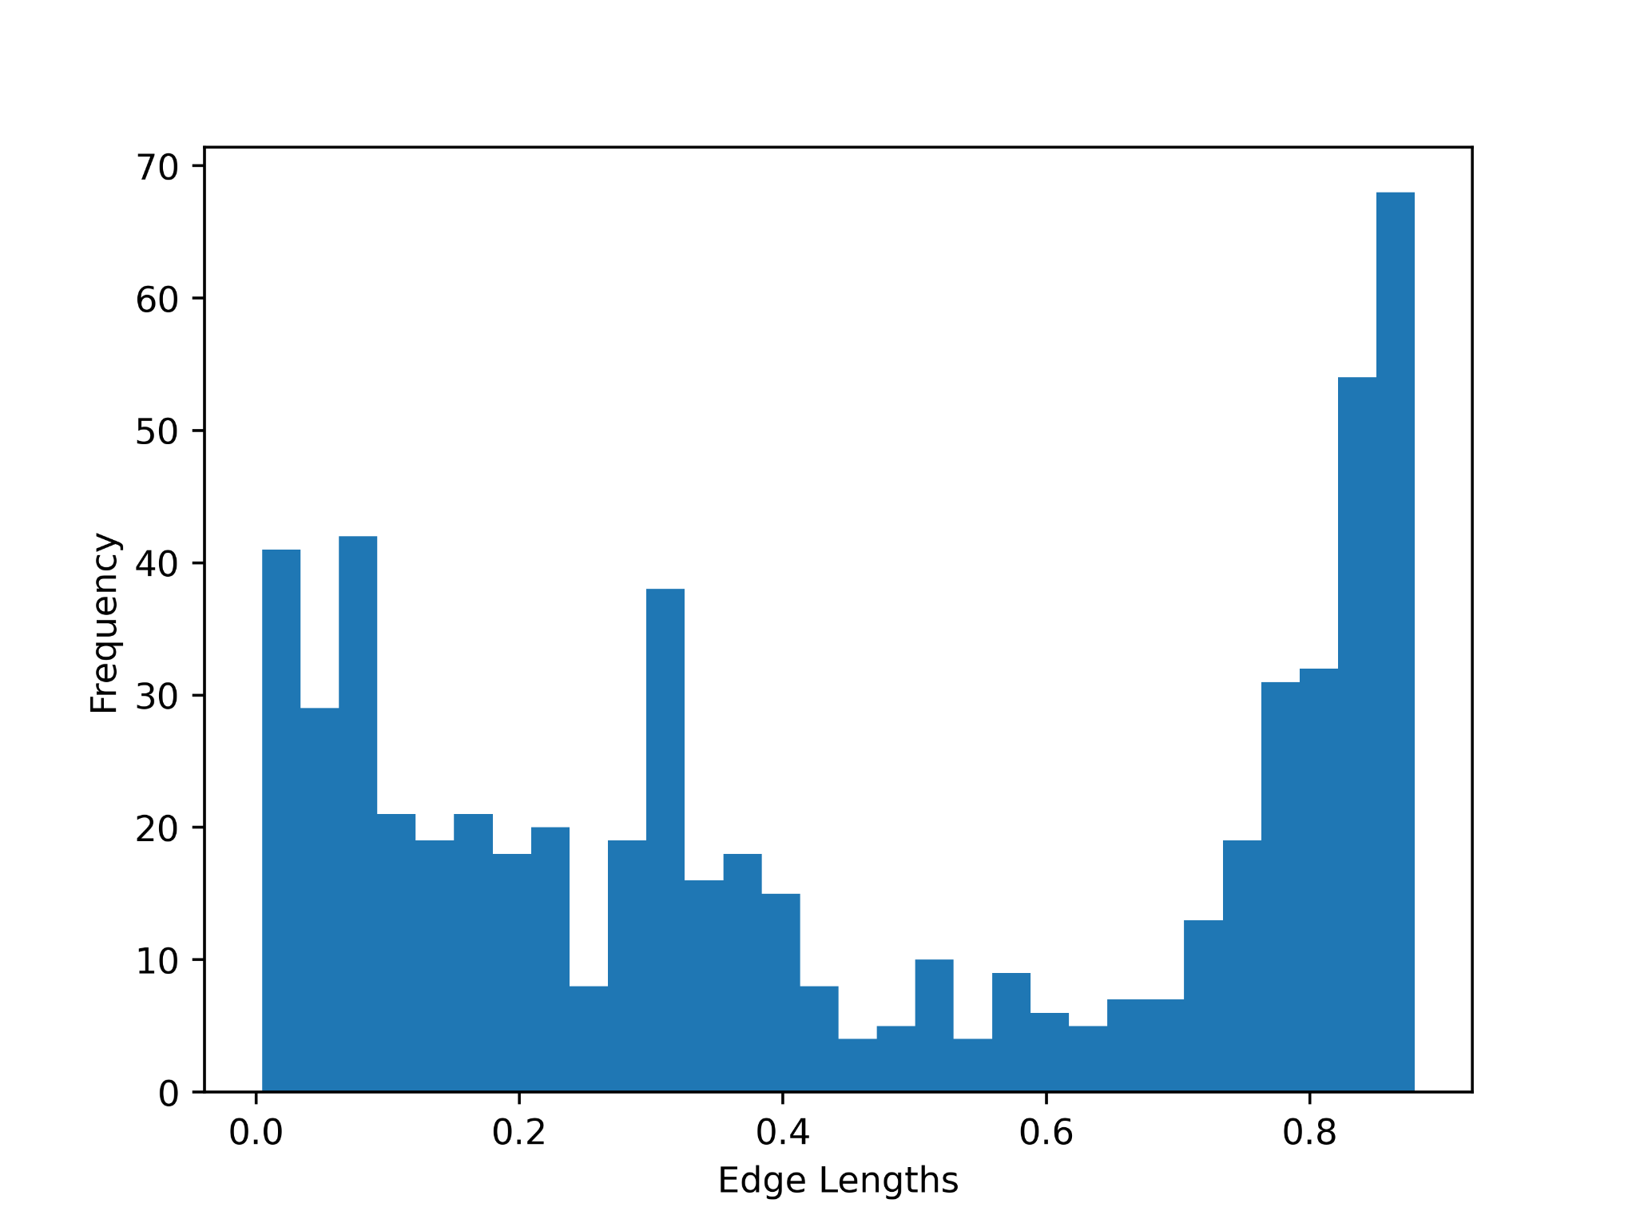
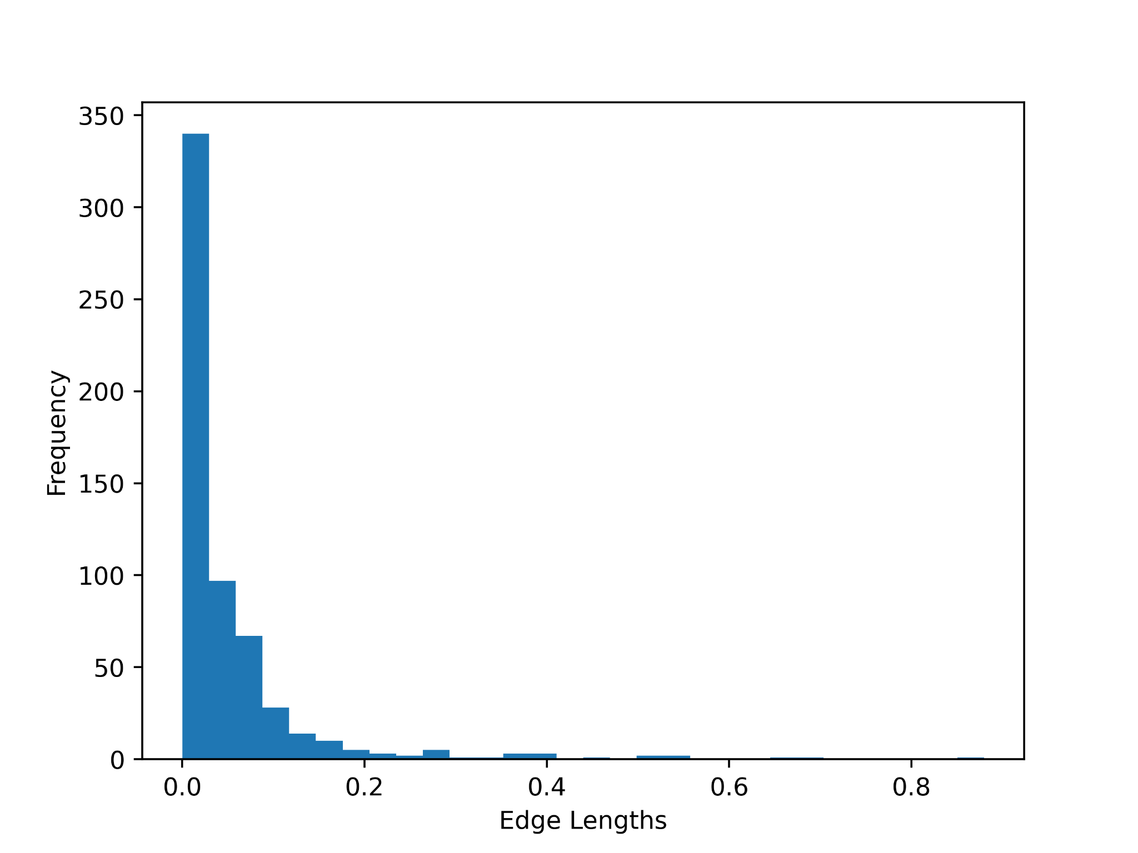
Task 3: Experiment Results
Histograms of the edge lengths obtained through Frechet Distance (Left): 0.8796899541048543
and Dynamic Time Warping (Right): 0.010766278086494052 with the trajectory pair (128-20080503104400, 128-20080509135846).

Slide 14
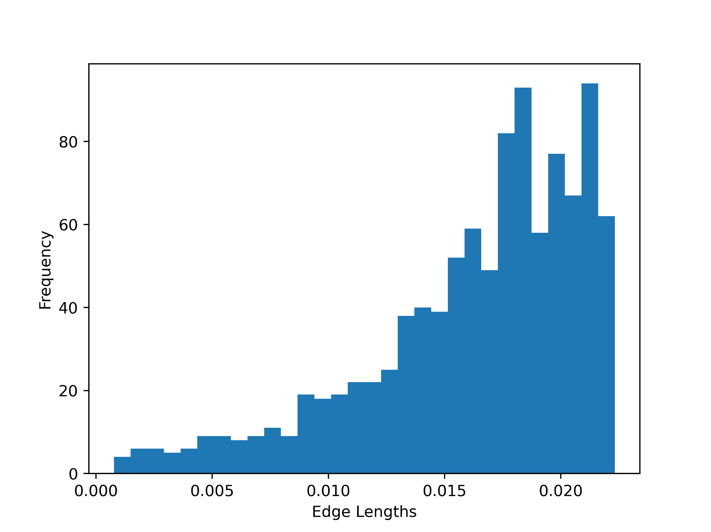
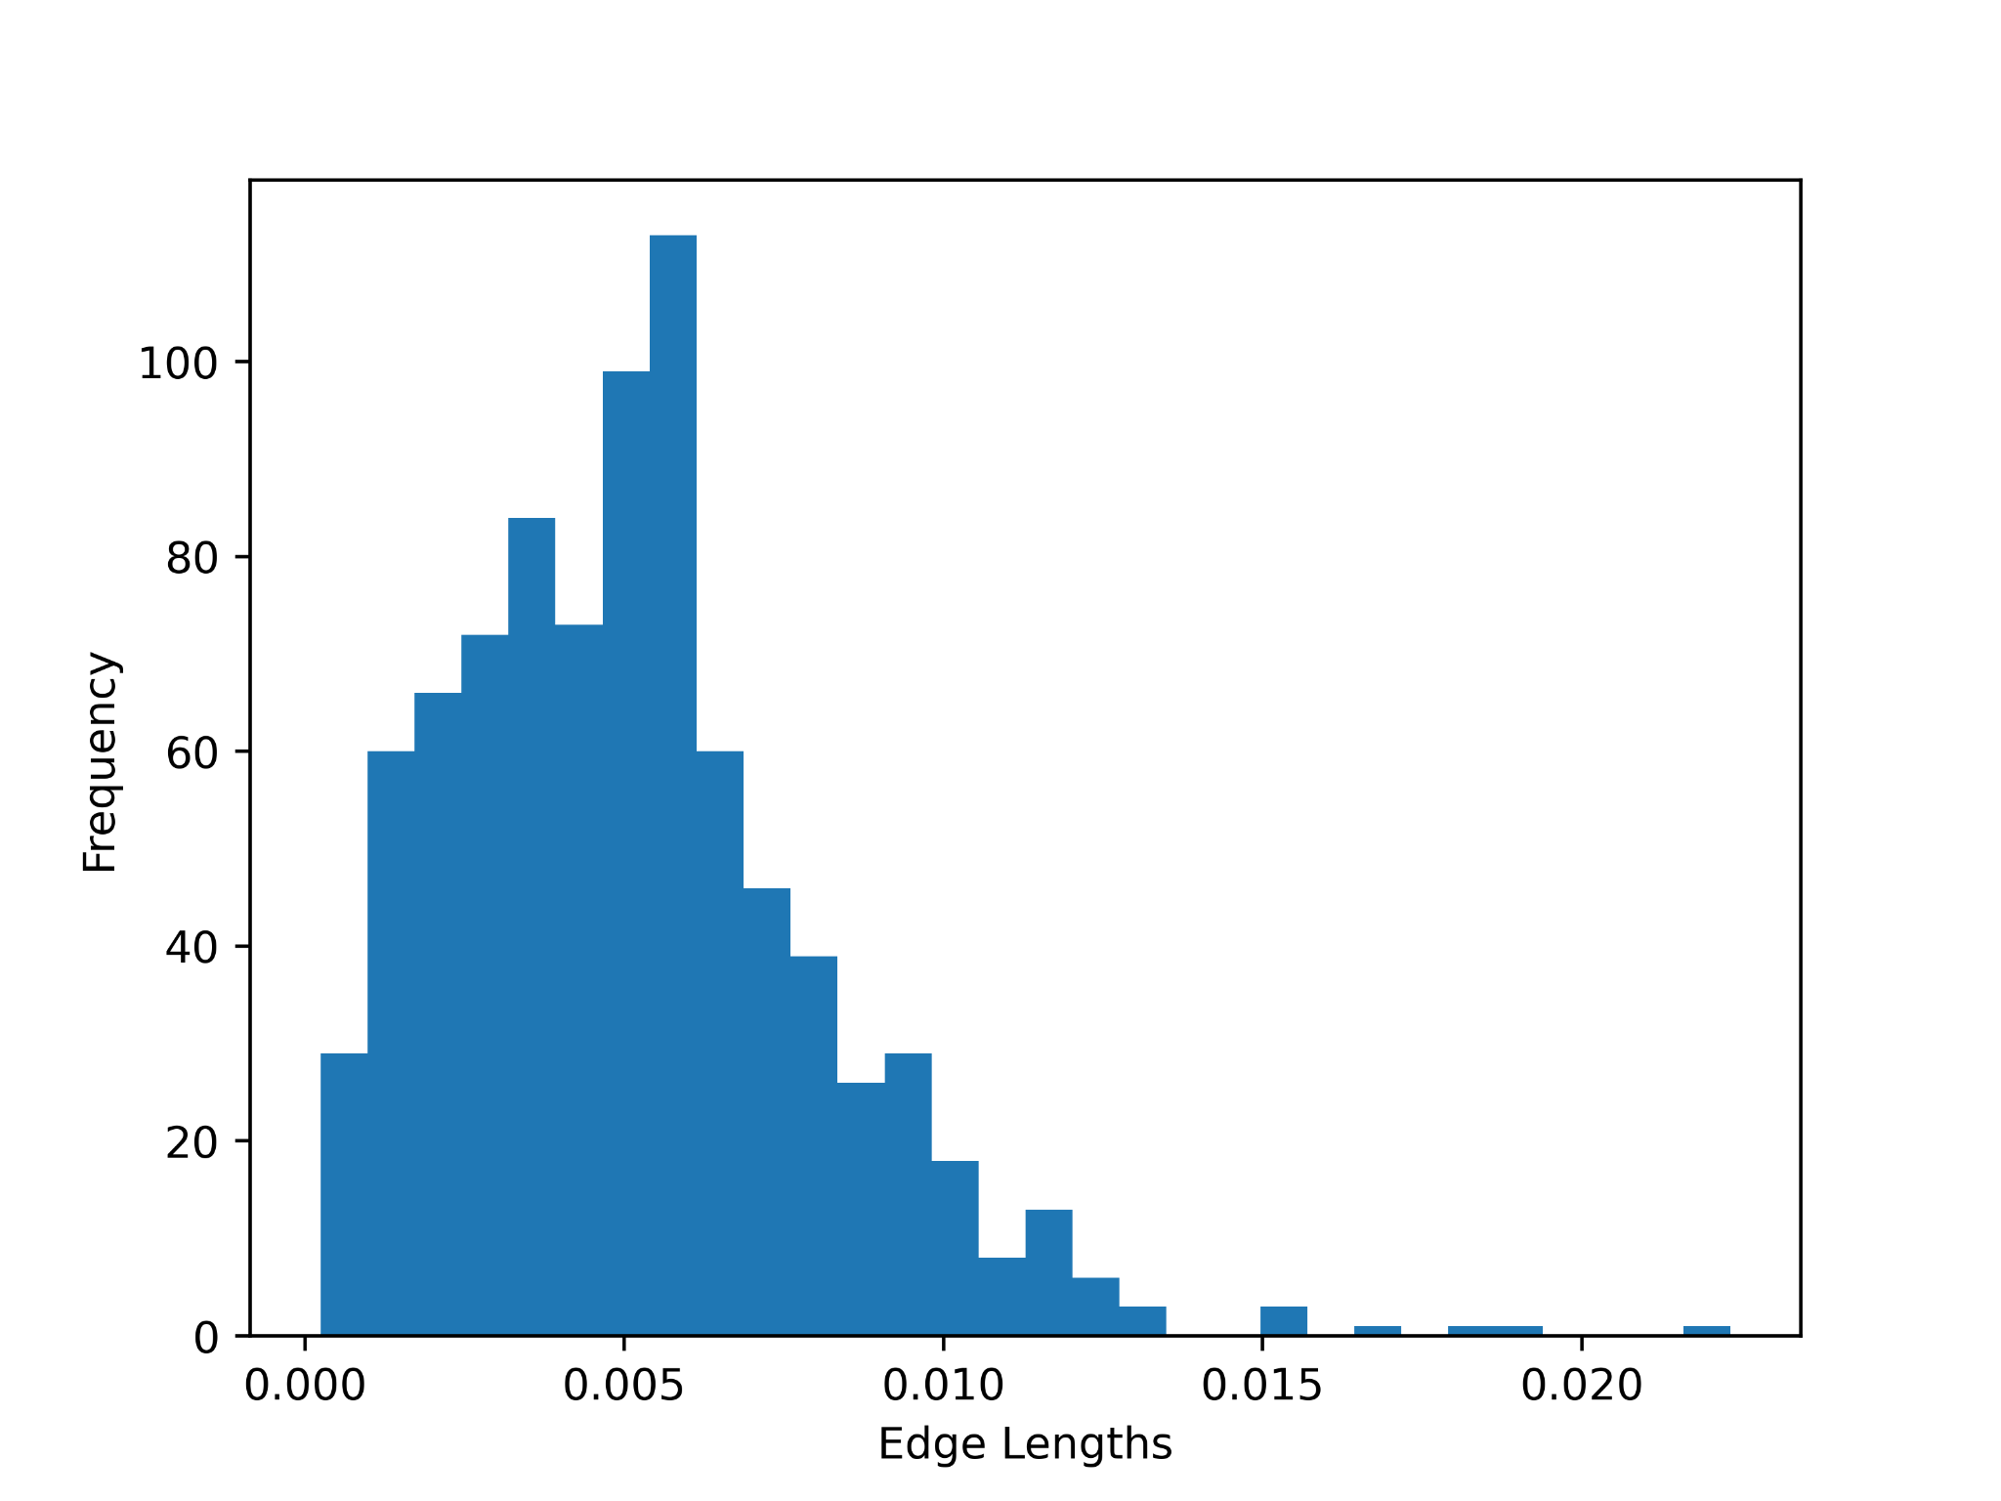
Task 3: Experiment Results
Histograms of the edge lengths obtained through Frechet Distance (Left): 0.02232791537515335
and Dynamic Time Warping (Right): 3.507729237132793e-05 with the trajectory pair (010-20081016113953, 010-20080923124453).

Slide 15
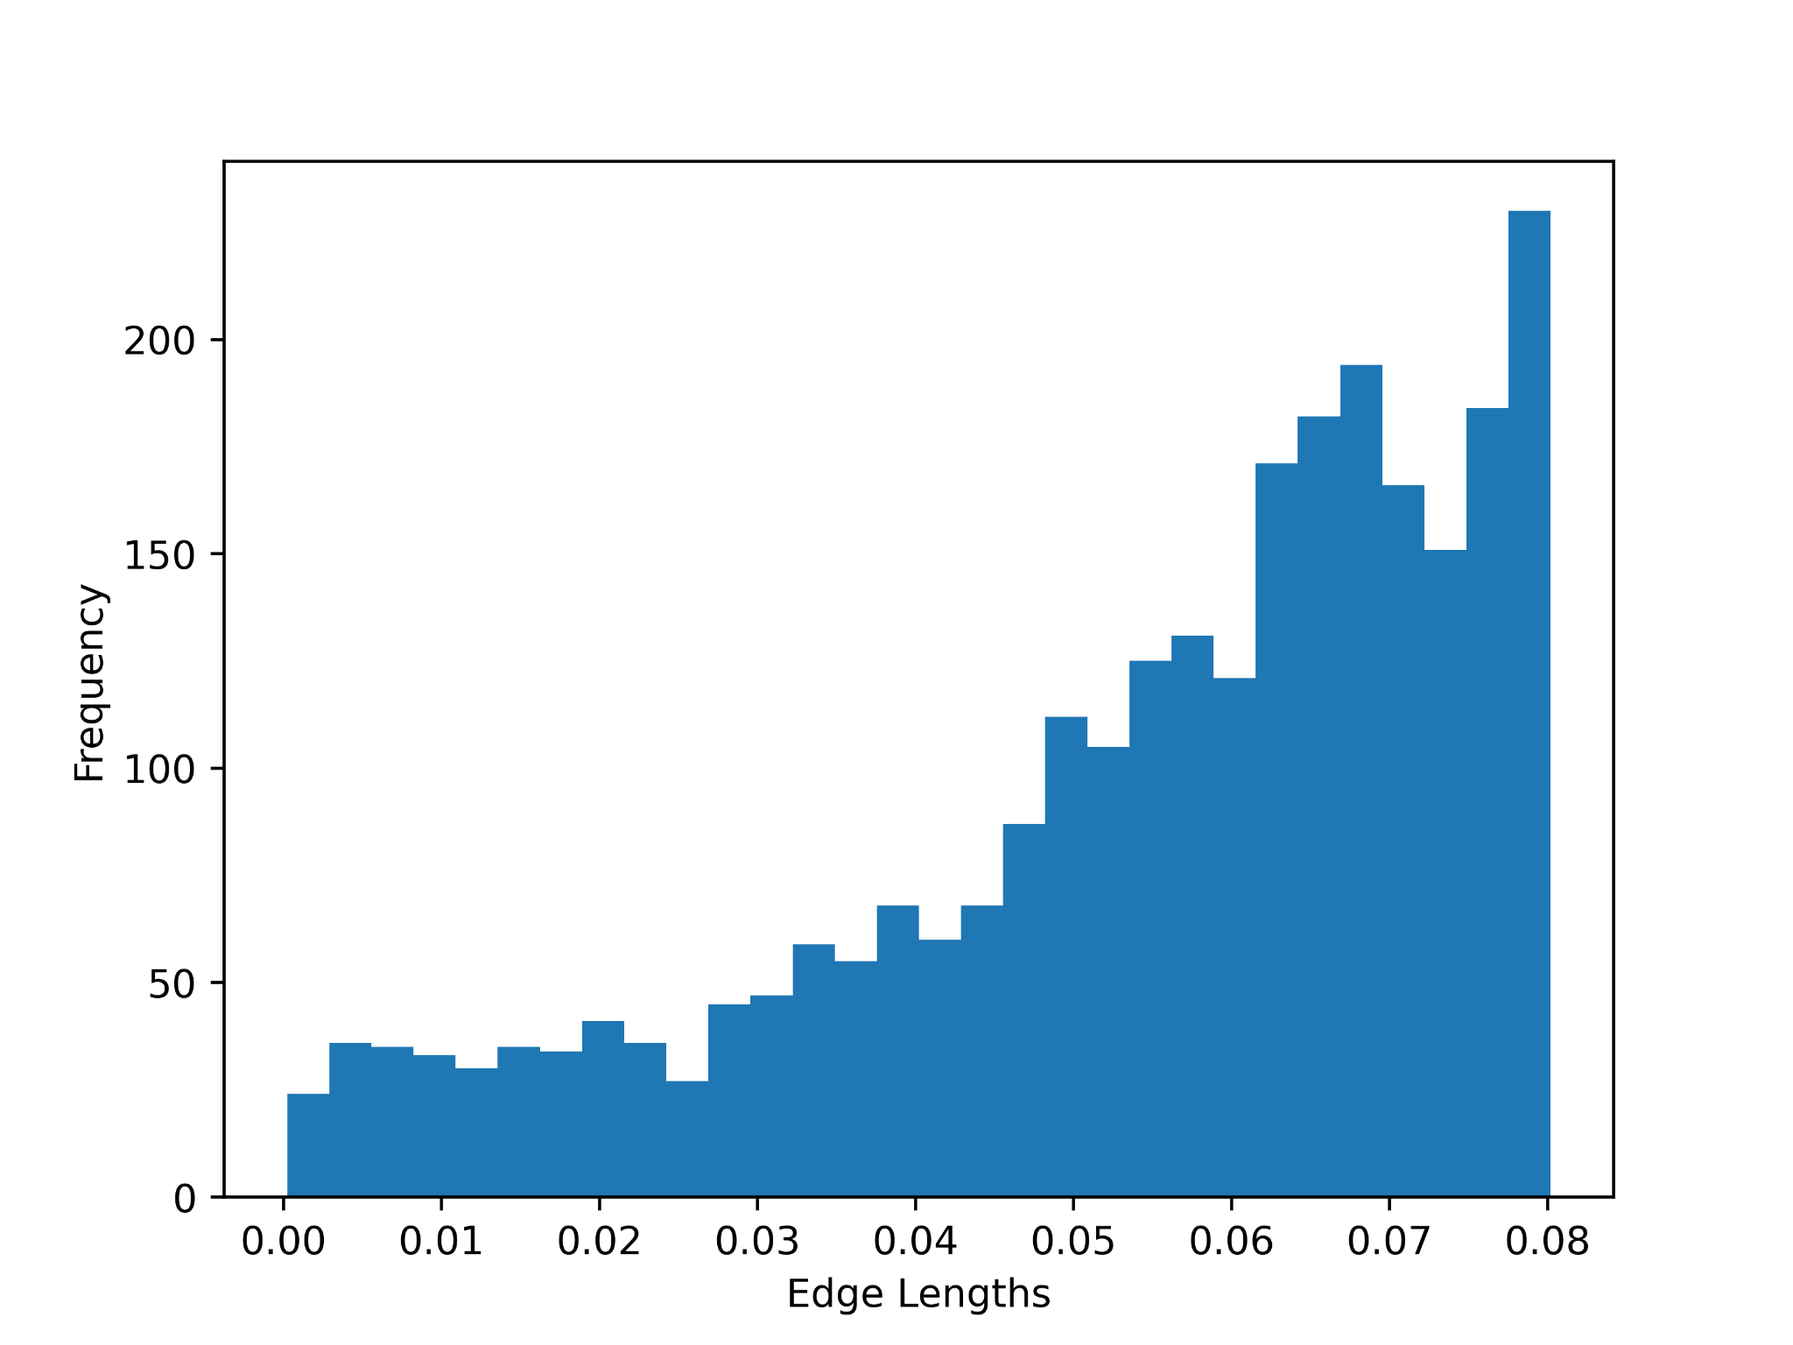
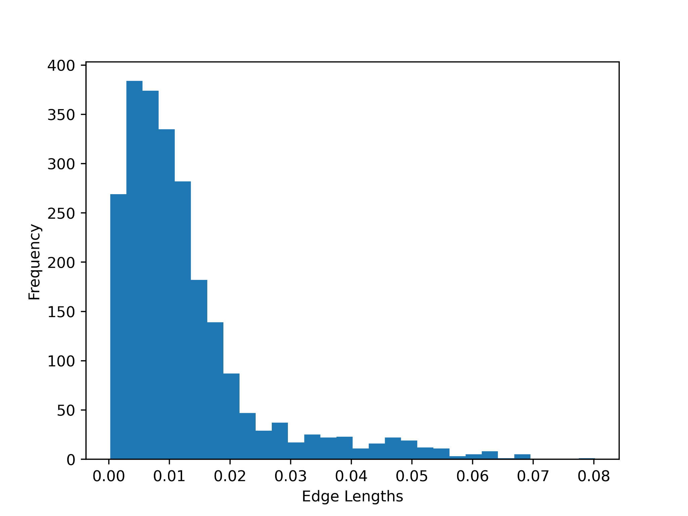
Task 3: Experiment Results
Histograms of the edge lengths obtained through Frechet Distance (Left): 0.08019256605197136
and Dynamic Time Warping (Right): 0.0002966240280566355 with the trajectory pair (115-20080520225850, 115-20080615225707).

Slide 16
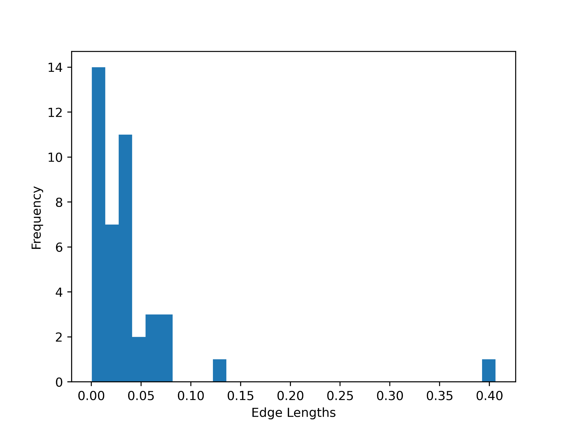
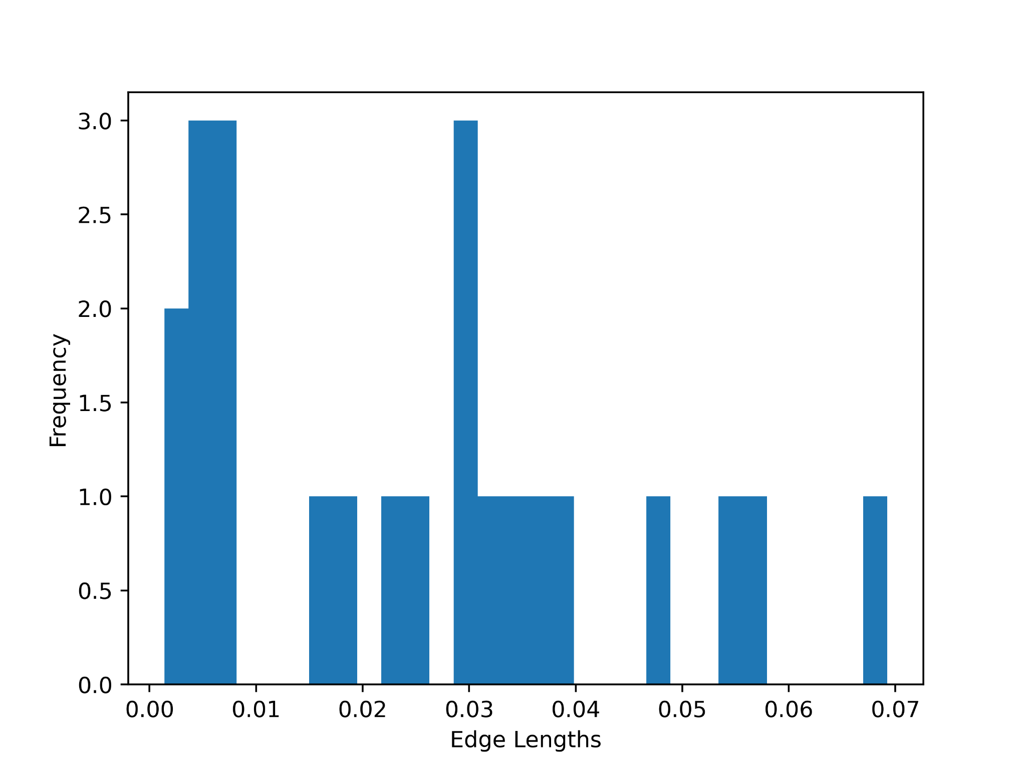
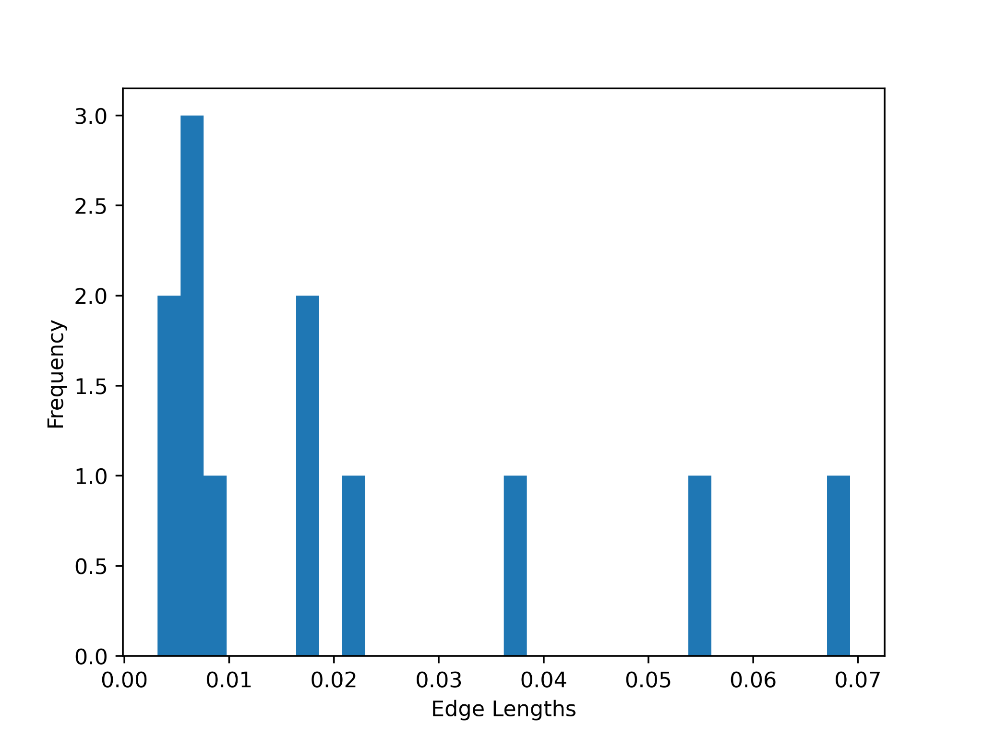
Task 3: Experimental Results
Histograms of the edge lengths obtained through Dynamic Time Warping after performing epsilon-simplification with epsilon = 0.03 (Left), 0.1 (Middle) and 0.3 (Right) with the trajectory pair (010-20081016113953, 010-20080923124453).
The DTW values are:
Epsilon = 0.03 DTW: 0.0053887374924999915
Epsilon = 0.1 DTW: 0.000989876166521727
Epsilon = 0.3 DTW: 0.0008866454650833266

Slide 17
Task 3: Fretchet Distance Discussion
Benefits
Relatively fast with memoization (Faster than Dynamic Time Warping)
Generates alignments with edge lengths that are all below a certain threshold. This is preferable if our goal is to limit worst-case misalignment.
Drawbacks
May produce alignments with many edges clustered around the max edge length. This appears to have occurred in our experiments, based on the histograms. This is not preferable if our goal is to limit average or total misalignment across all points.
A measure of center, such as mean or median, would be a more suitable alternative.

Slide 18
Task 3: Dynamic Time Warping Discussion
Benefits
Generates alignments that minimizes average or total misalignment across all points.
In our experiments, DTW appears to have generated alignments with lower mean and max edge lengths compared to Fretchet Distance, based on the histograms.
Drawbacks
Relatively slow (Slower than Fretchet Distance). This is because we iterate through 3 different arrays of size |P| by |Q|, so our Dynamic Time Warping algorithm is about 3 times slower than our Fretchet Distance algorithm.
May produce alignments with several edges that are extremely long. This does not appear to have occurred in our experiments, but is a theoretical possibility, since mean is not robust to outliers.

Slide 19
Contributions
Haris Adnan: Part 2: Trajectory Simplification
Quan Doan: Part 2: Trajectory Simplification, Slides/Formatting
Alexander Du: Part 1 Density/Hubs, Frechet/DTW, Slides/Formatting
Jerry Xin: Part 3: Frechet/DTW*, Slides/Formatting
*Primary Contributor

